Slide 1
SHEET METALWORKING
‹#›

Slide 2
SHEET METALWORKING
Cutting Operations
Bending Operations
Drawing
Sheet Metal Operations Not Performed on Presses
‹#›

Slide 3
Sheet Metalworking Defined
Cutting and forming operations performed on relatively thin sheets of metal
Thickness of sheet metal = 0.4 mm (1/64 in) to 6 mm (1/4 in)
Thickness of plate stock > 6 mm
Operations usually performed as cold working
‹#›

Slide 4
Metals used for sheets
There are many different metals that can be made into sheet metal, such as aluminum, brass, copper, steel, tin, nickel and titanium. For decorative uses, important sheet metals include silver, gold, and platinum (platinum sheet metal is also utilized as a catalyst.)
‹#›

Slide 5
Steel (American Wire Gauge in inch)
Gauge | Thickness
28 26 24 22 20 18 16 14 12 11 10 8 7 | 0.015” 0.018” 0.024” 0.030” 0.036” 0.048” 0.060” 0.075” 0.105 0.120” 0.134” 0.160” 0.1874”
‹#›

Slide 6
Aluminium (AWG in inch)
Gauge | Thickness
22 20 18 16 14 12 11 10 | 025” 0.032” 0.040” 0.050” 0.063” 0.080” 0.090” 0.100” 0.125” 0.160” 0.190”
‹#›

Slide 7
Sheet and Plate Metal Products
Sheet and plate metal parts for consumer and industrial products such as
Automobiles and trucks
Airplanes
Railway cars and locomotives
Farm and construction equipment
Small and large appliances
Office furniture
Computers and office equipment
‹#›

Slide 8
Advantages of Sheet Metal Parts
High strength
Good dimensional accuracy
Good surface finish
Relatively low cost
For large quantities, economical mass production operations are available
‹#›

Slide 9
Sheet Metalworking Terminology
“Punch‑and‑die”
Tooling to perform cutting, bending, and drawing
“Stamping press”
Machine tool that performs most sheet metal operations
“Stampings”
Sheet metal products
‹#›

Slide 10
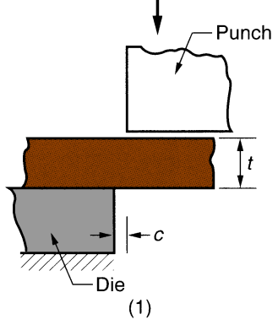
Three Major Categories of Sheet Metal Processes
Cutting
Shearing to separate large sheets; or cut part perimeters or make holes in sheets
Bending
Straining sheet around a straight axis
Drawing
Forming of sheet into convex or concave shapes
‹#›

Slide 11
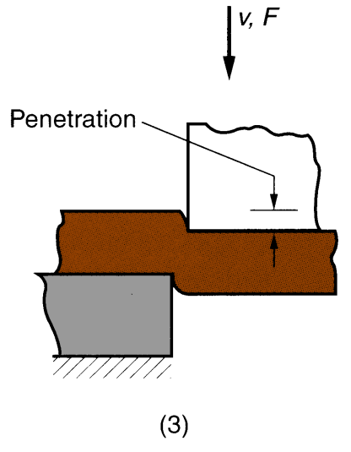
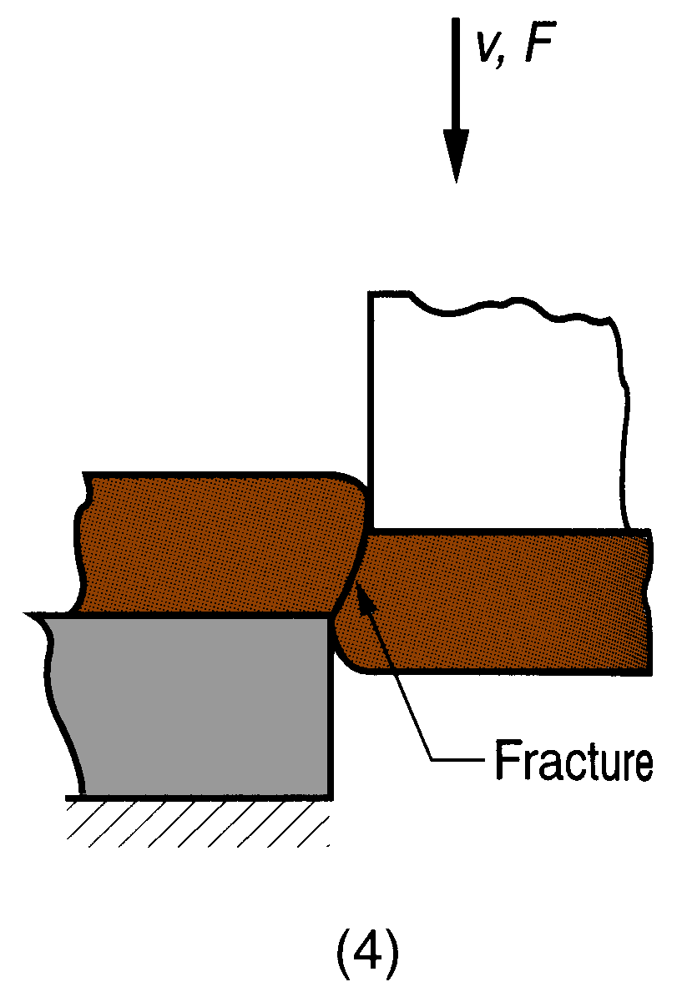
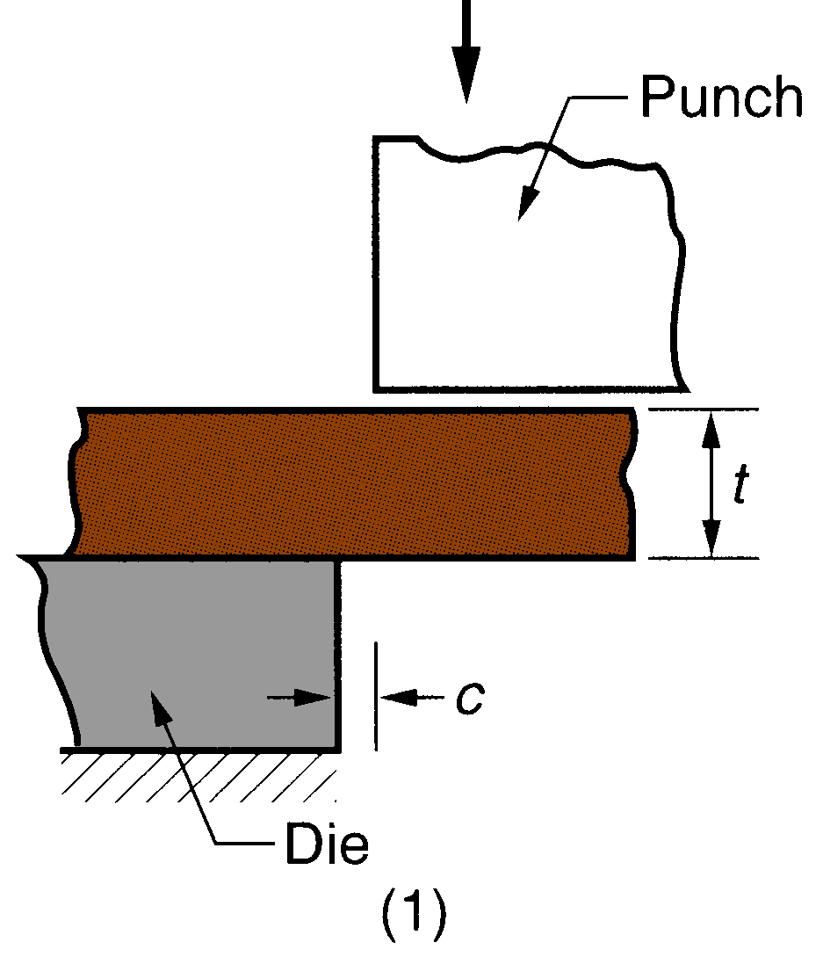
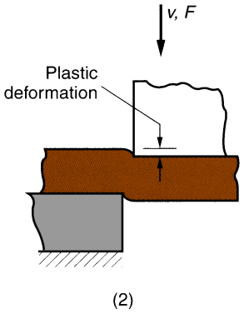
I. Cutting
Shearing between two sharp cutting edges
‹#›

Slide 12
Shearing, Blanking, and Punching
Three principal operations in pressworking that cut sheet metal:
Shearing
Blanking
Punching
‹#›

Slide 13
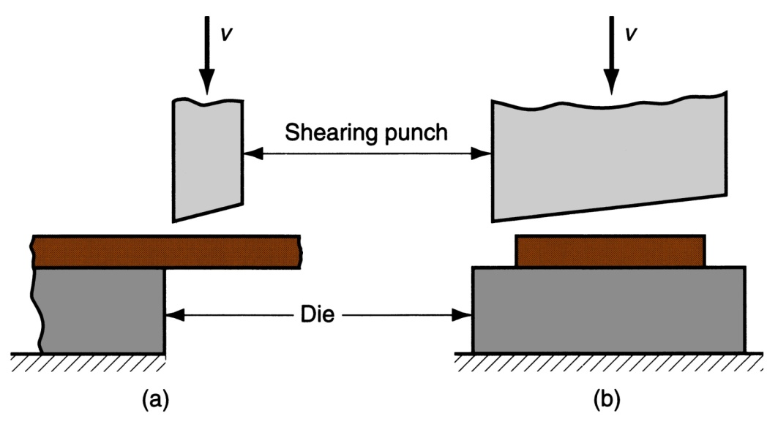
Shearing
Sheet metal cutting operation along a straight line between two cutting edges
Typically used to cut large sheets into smaller sections for subsequent operations
‹#›

Slide 14
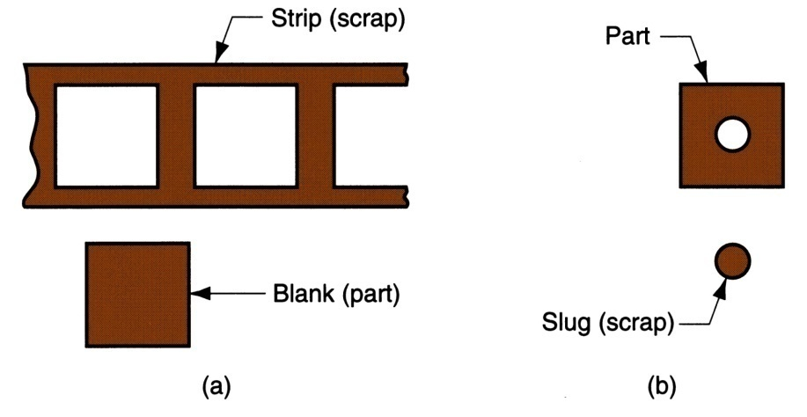
Blanking and Punching
Blanking - sheet metal cutting to separate piece from surrounding stock
Cut piece is the desired part, called a blank
Punching - sheet metal cutting similar to blanking except cut piece is scrap, called a slug
Remaining stock is the desired part
(a) Blanking and (b) punching
‹#›

Slide 15
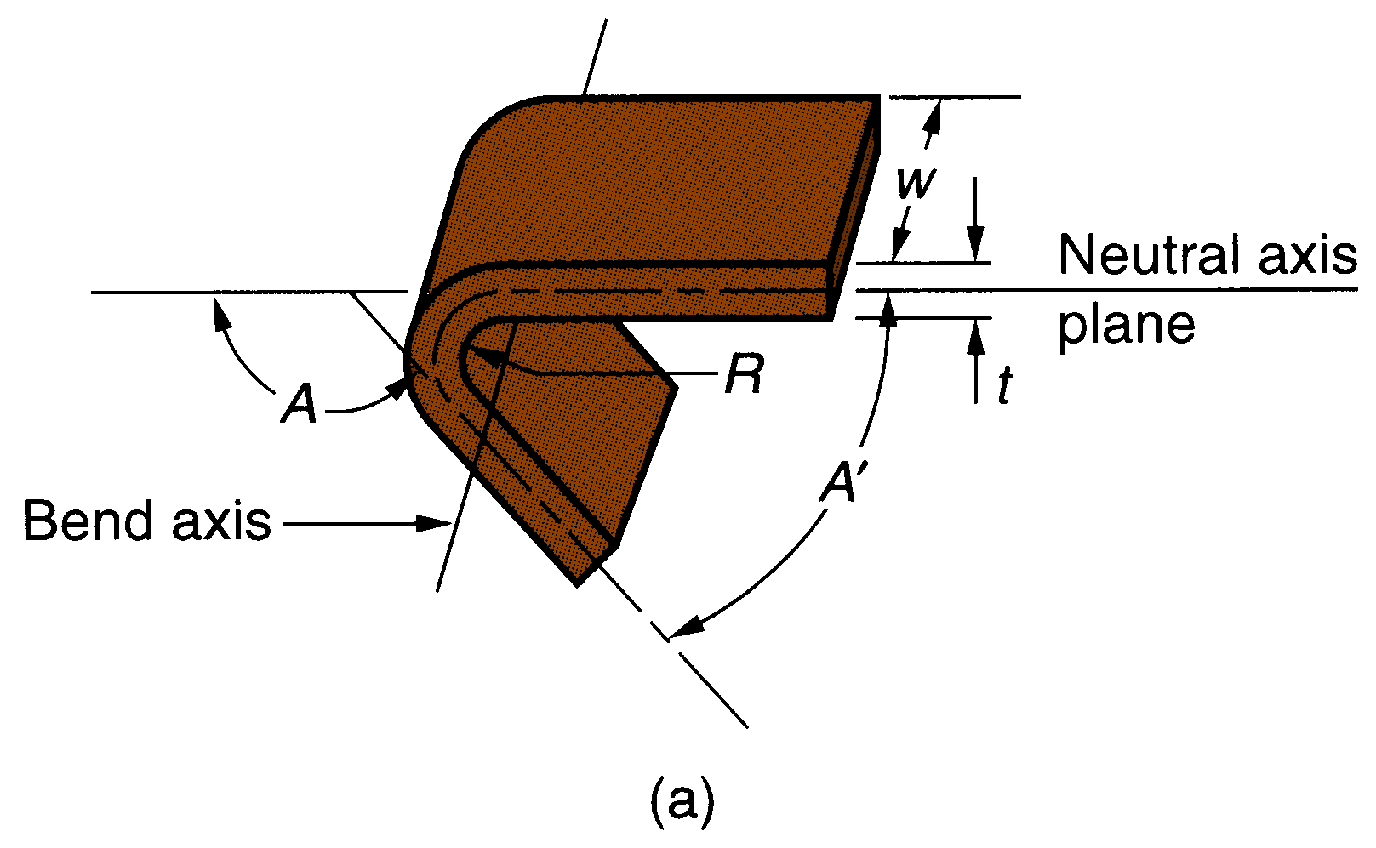
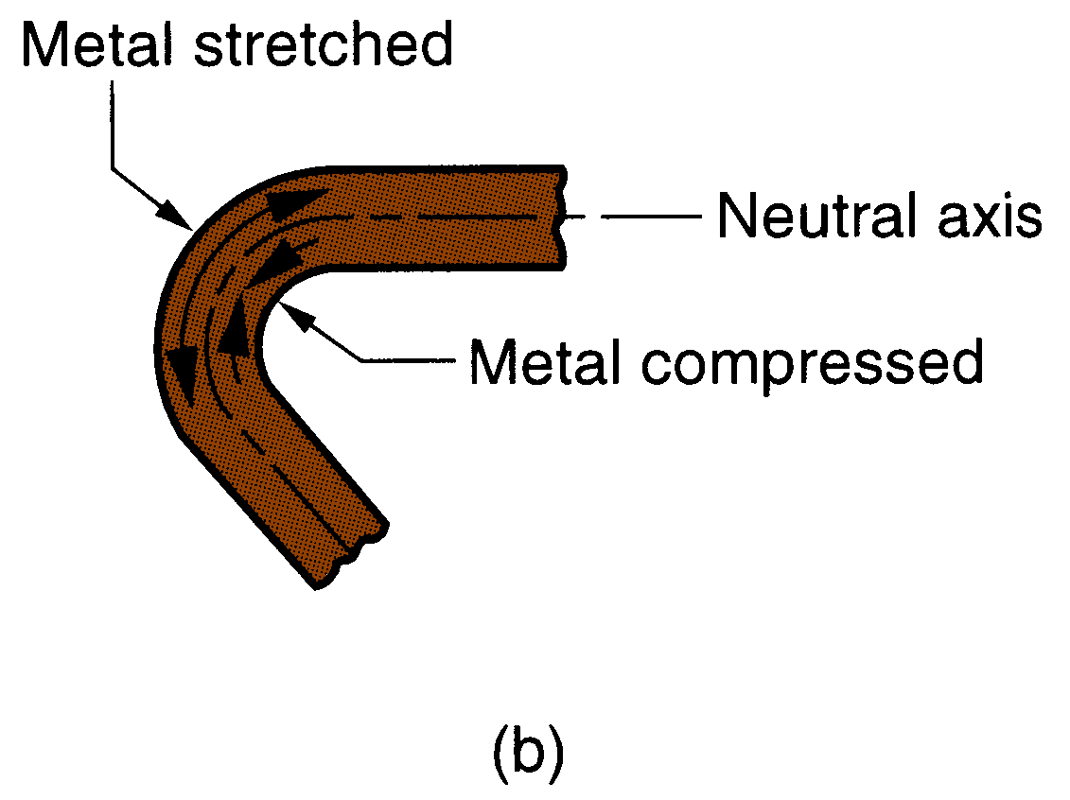
II. Bending
Straining sheetmetal around a straight axis to take a permanent bend
(a) Bending of sheet metal
(b) both compression and tensile elongation of the metal occur in bending
‹#›

Slide 16
Types of Sheetmetal Bending
V‑bending - performed with a V‑shaped die
Edge bending - performed with a wiping die
‹#›

Slide 17
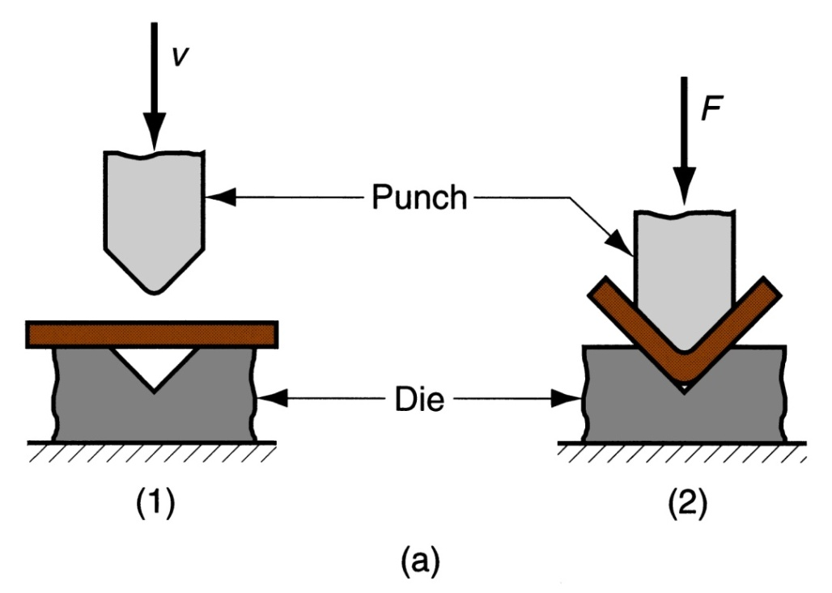
V-Bending
For low production
Performed on a press brake
V-dies are simple and inexpensive
‹#›

Slide 18
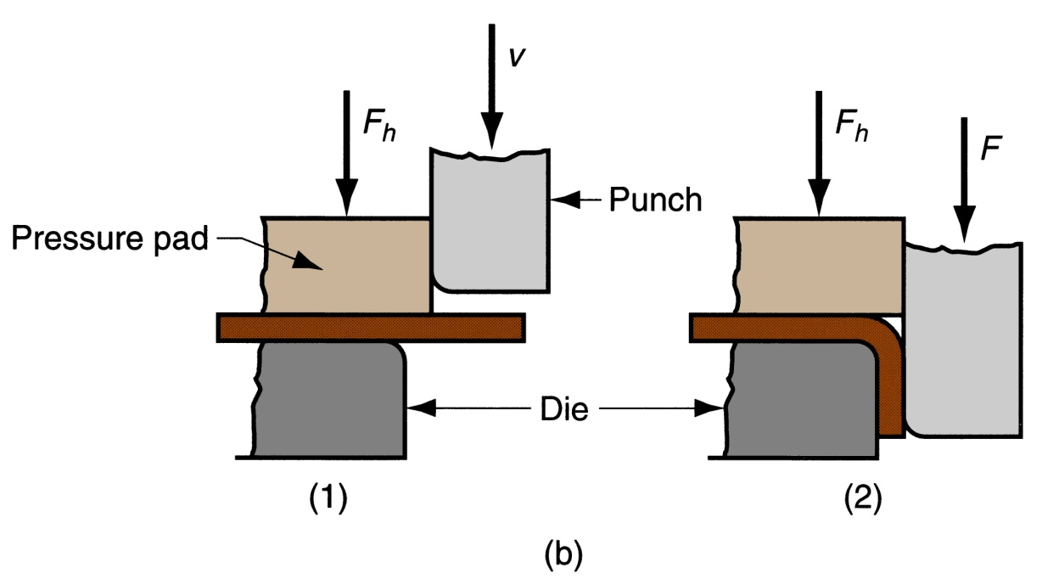
Edge Bending
For high production
Pressure pad required
Dies are more complicated and costly
‹#›

Slide 19
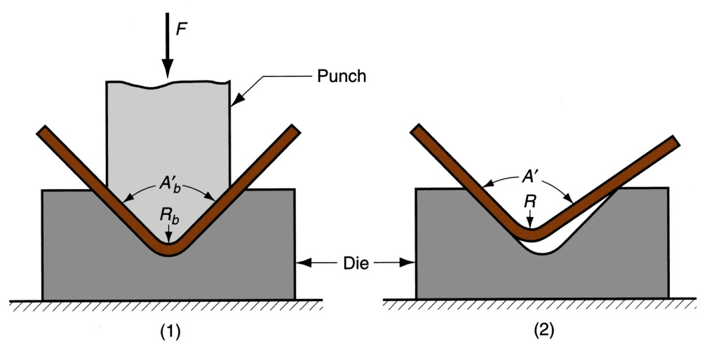
Springback in Bending
Springback = increase in included angle of bent part relative to included angle of forming tool after tool is removed
Reason for springback:
When bending pressure is removed, elastic energy remains in bent part, causing it to recover partially toward its original shape
‹#›

Slide 20
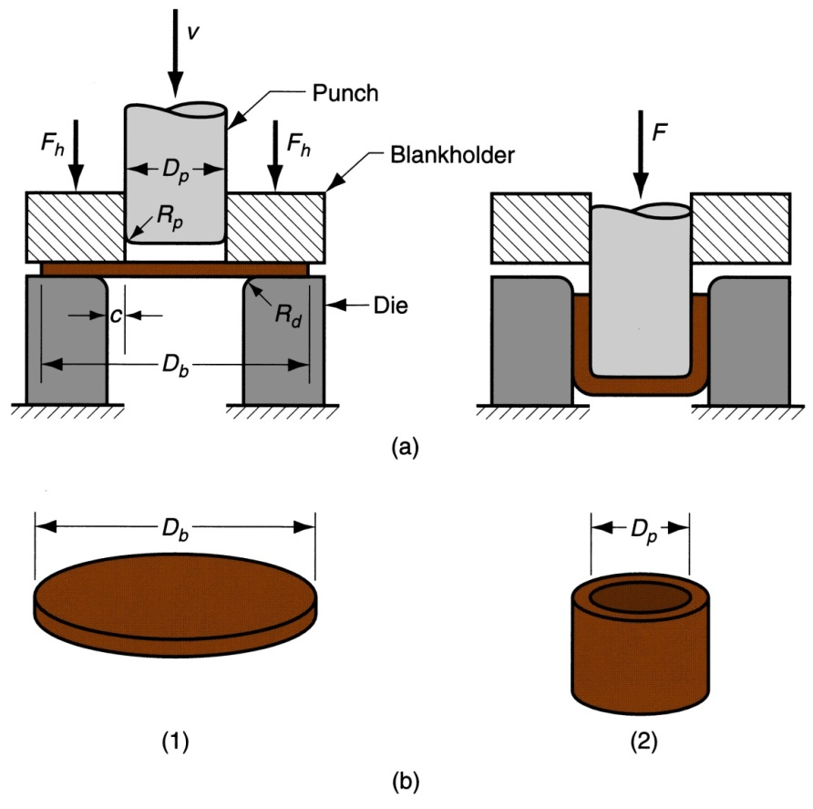
III. Drawing
Sheet metal forming to make cup‑shaped, box‑shaped, or other complex‑curved, hollow‑shaped parts
Products: beverage cans, ammunition shells, automobile body panels
‹#›

Slide 21
IV. Shapes other than Cylindrical Cups
Square or rectangular boxes (as in sinks),
Stepped cups,
Cones,
Cups with spherical rather than flat bases,
Irregular curved forms (as in automobile body panels)
Each of these shapes presents its own unique technical problems in drawing
‹#›

Slide 22
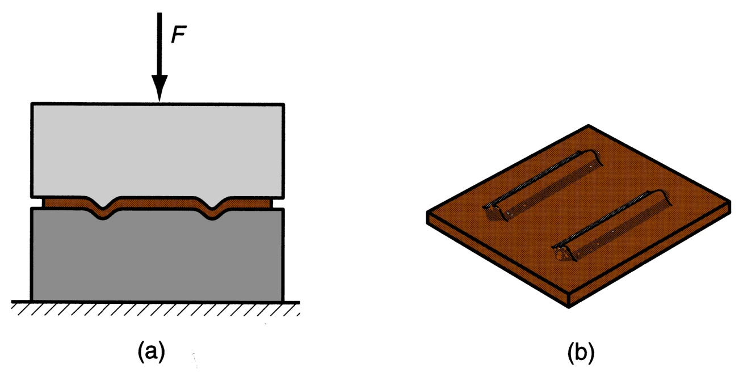
Embossing
Used to create indentations in sheet, such as raised (or indented) lettering or strengthening ribs
Embossing: (a) cross‑section of punch and die configuration during pressing; (b) finished part with embossed ribs
‹#›

Slide 23
Power and Drive Systems
Hydraulic presses - use a large piston and cylinder to drive the ram
Longer ram stroke than mechanical types
Suited to deep drawing
Slower than mechanical drives
Mechanical presses – convert rotation of motor to linear motion of ram
High forces at bottom of stroke
Suited to blanking and punching
‹#›

Slide 24
Sheet Metal Operations Not Performed on Presses
Stretch forming
Spinning
‹#›

Slide 25
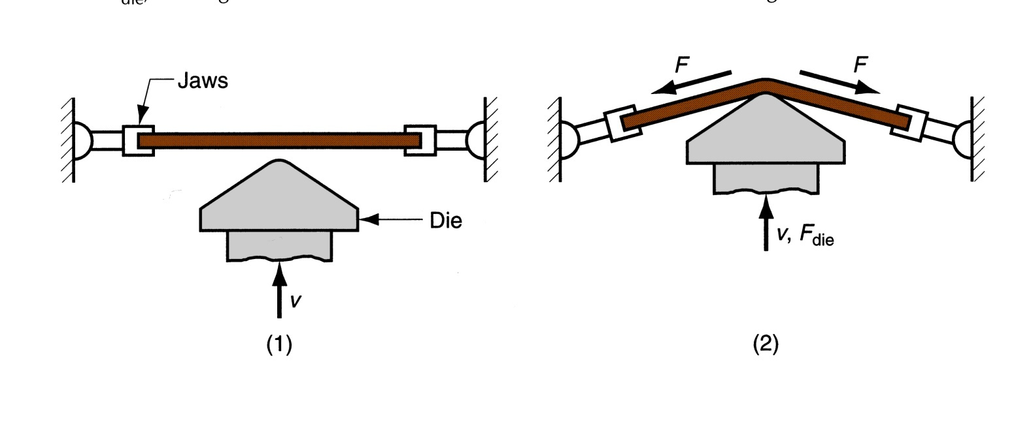
1. Stretch Forming
Sheet metal is stretched and simultaneously bent to achieve shape change
Stretch forming: (1) start of process; (2) form die is pressed into the work with force F_{die}, causing it to be stretched and bent over the form. F = stretching force
‹#›

Slide 26
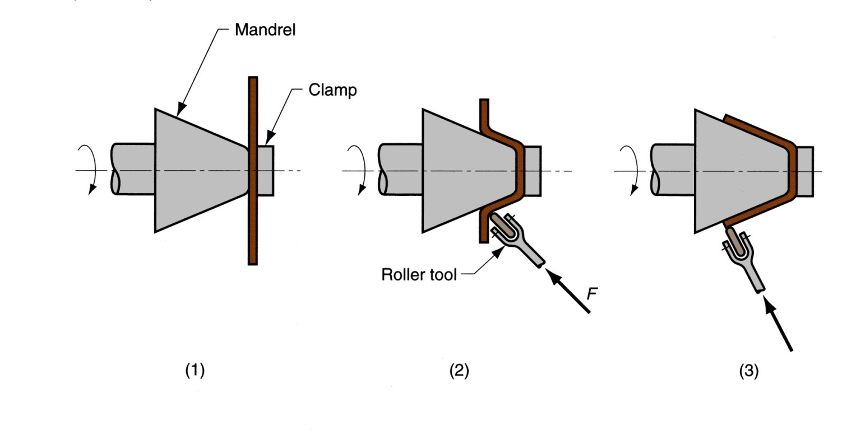
2. Spinning
Metal forming process in which an axially symmetric part is gradually shaped over a rotating mandrel using a rounded tool or roller
Conventional spinning: (1) setup at start of process; (2) during spinning; and (3) completion of process
‹#›

